Slide 1
STUDENT FEEDBACK AND TEACHING IMPROVEMENT ANALYZER

Slide 2
FACULTY-WISE AVERAGE PERFORMANCE
Interpretation
The pivot table analysis reveals noticeable variation in faculty performance based on average student ratings. While a few faculty members such as Ms. Pavithra and Dr. Meenakshi demonstrate superior teaching effectiveness with the highest average scores, the majority fall within a moderate performance range. Some faculty members exhibit comparatively lower ratings, indicating the need for improvements in teaching clarity, student engagement, and instructional methods. Overall, the results highlight a balanced performance distribution with scope for targeted faculty development initiatives.

Slide 3
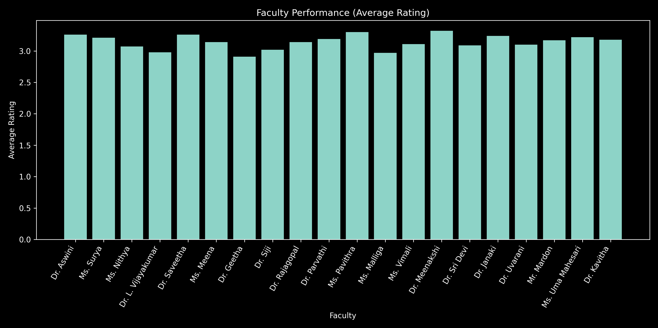

Slide 4
COURSE-WISE PERFORMANCE (AVERAGE RATING)
Interpretation
The course-wise analysis reveals significant variation in student satisfaction levels across different subjects. Courses such as Investment Analysis and HRM demonstrate the highest satisfaction ratings, indicating effective teaching methodologies and strong student engagement. In contrast, courses like Forensic Accounting and Programming with C show comparatively lower ratings, highlighting the need for improved instructional strategies, practical exposure, and enhanced clarity. Overall, the findings suggest that while most courses perform at a moderate level, targeted improvements in specific subjects can significantly enhance overall academic effectiveness.

Slide 5
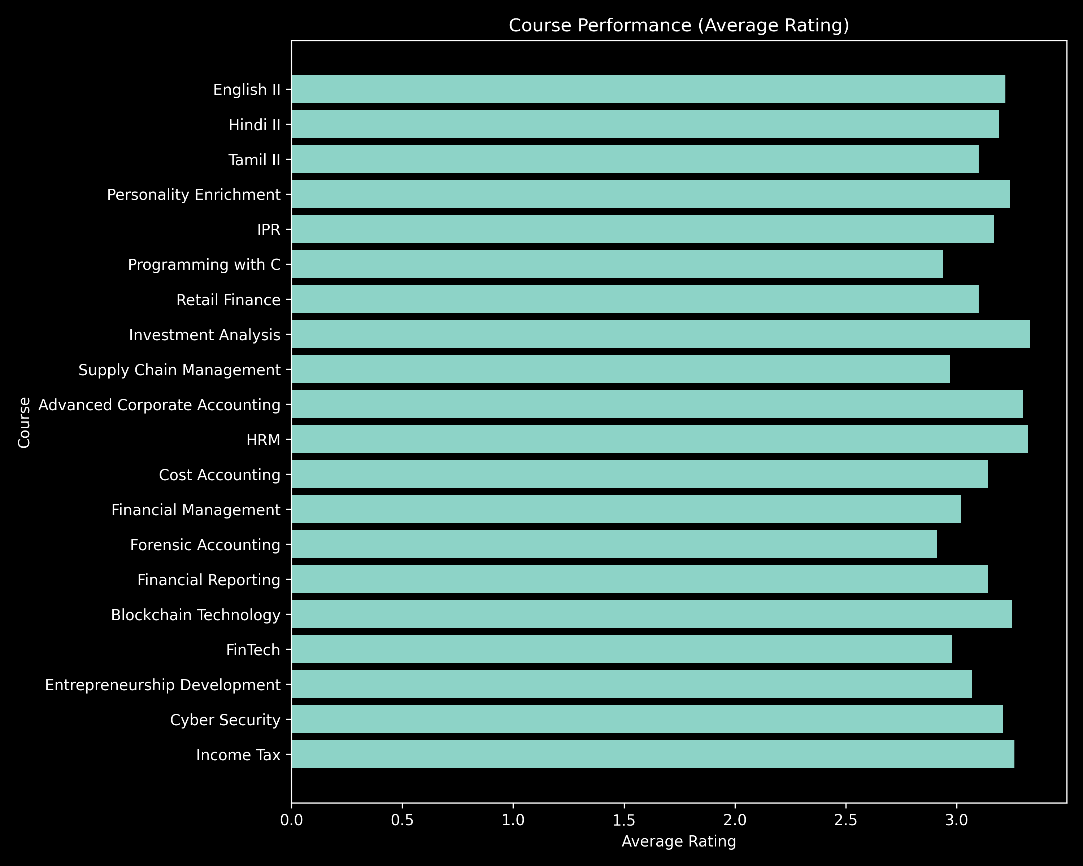

Slide 6
FACULTY VS. COURSE MATRIX (AVERAGE RATING)
Interpretation
The faculty–course matrix shows that teaching performance varies across subjects, indicating faculty-specific strengths in certain courses. Courses like Banking and HRM receive higher ratings, while Business Management and Operations show relatively lower performance. This suggests the need to align faculty expertise with appropriate courses to improve overall student satisfaction.

Slide 7
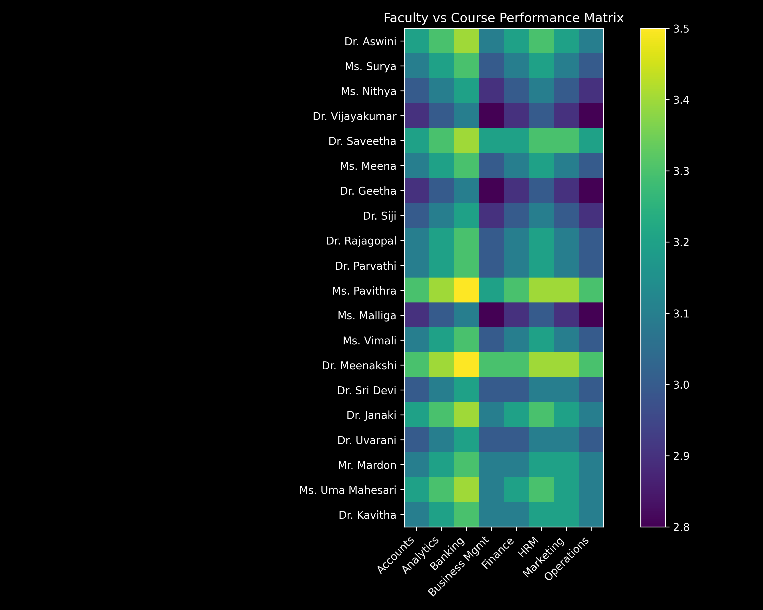

Slide 8
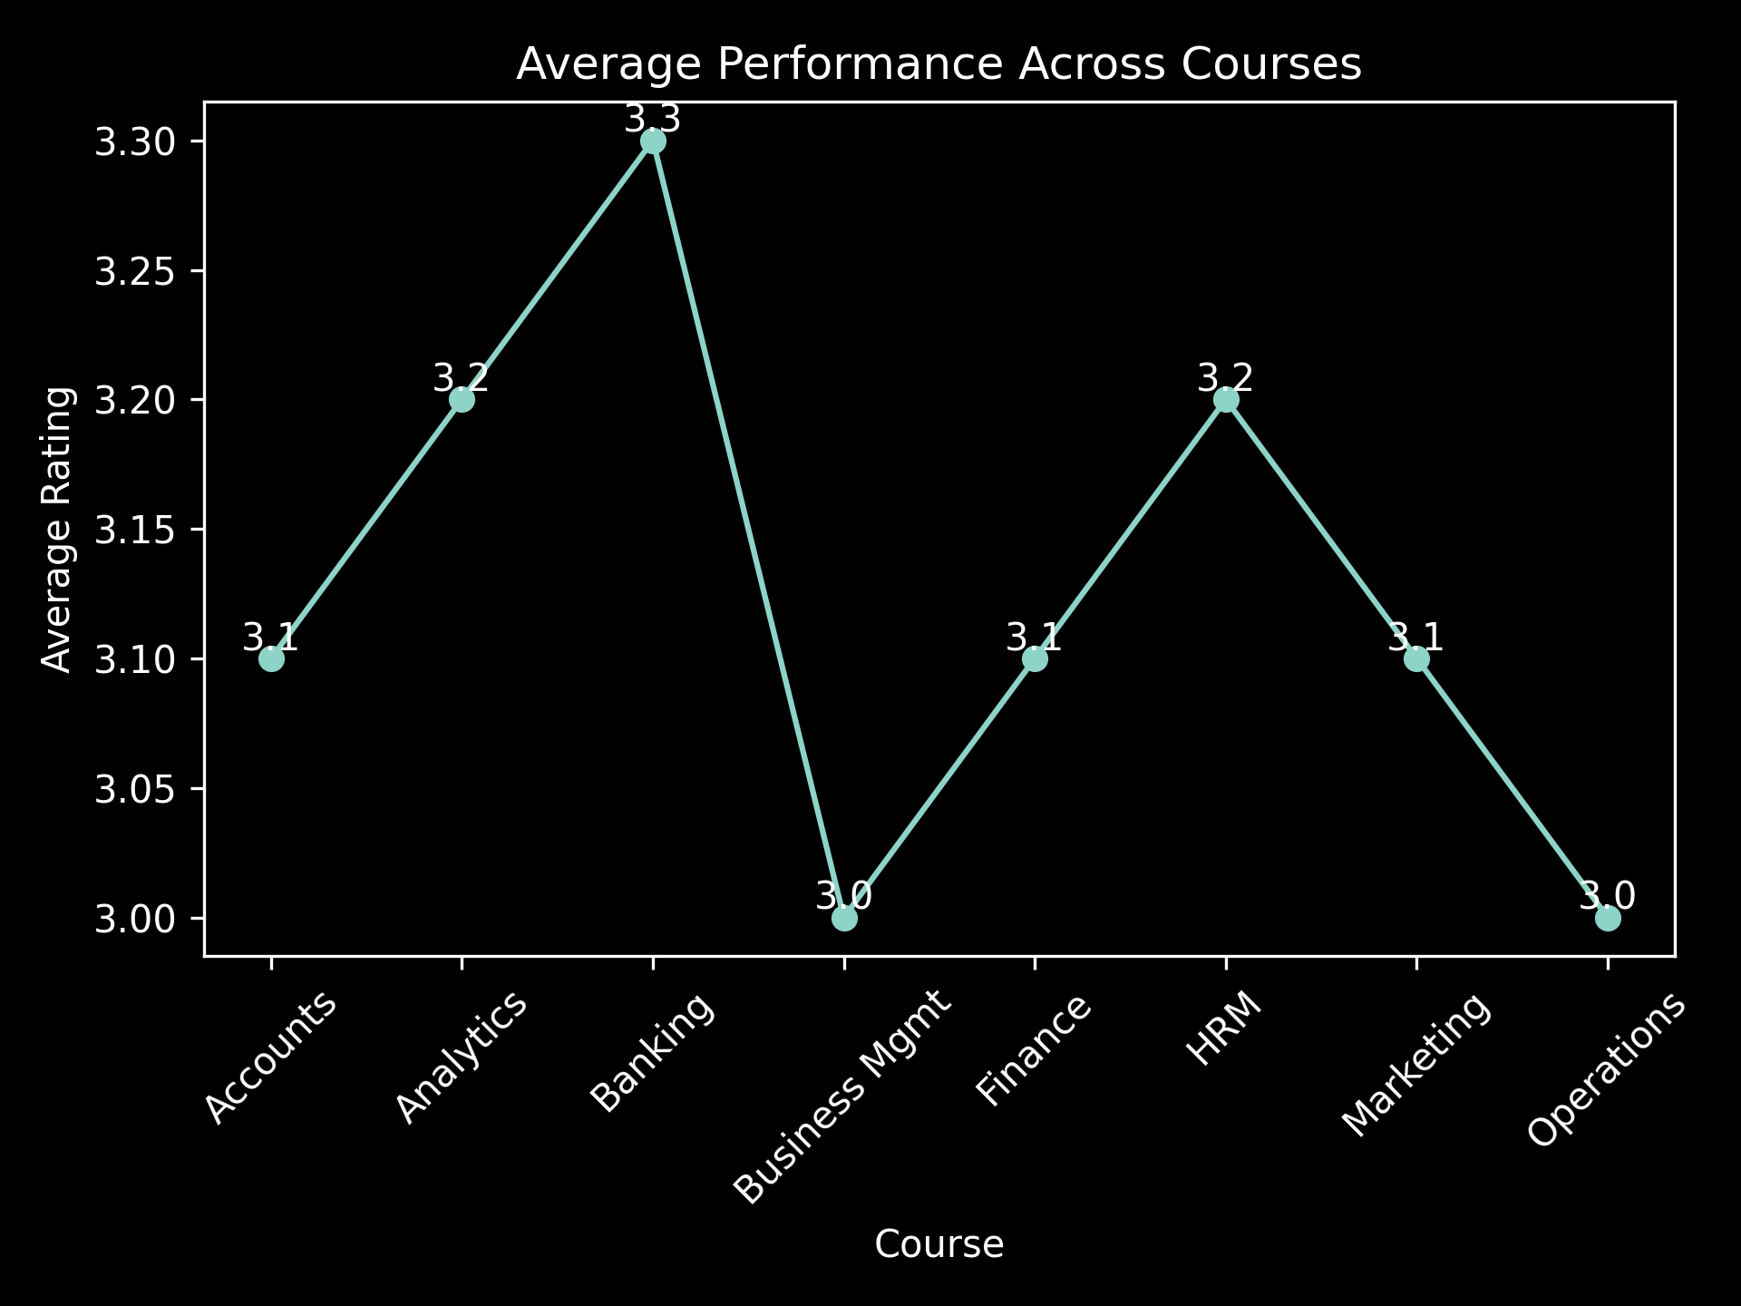

Slide 9
QUESTION-WISE ANALYSIS
Interpretation
The question-wise analysis reveals moderate variation in student feedback across different teaching parameters. Certain aspects, particularly Q19, Q8, and Q6, receive higher ratings, indicating strong performance in those areas. In contrast, lower ratings observed in Q17, Q15, and Q18 highlight areas requiring improvement, especially in enhancing clarity, engagement, and instructional effectiveness. Overall, the results suggest consistent performance across most parameters, with scope for targeted improvements to enhance overall teaching quality and student satisfaction.

Slide 10
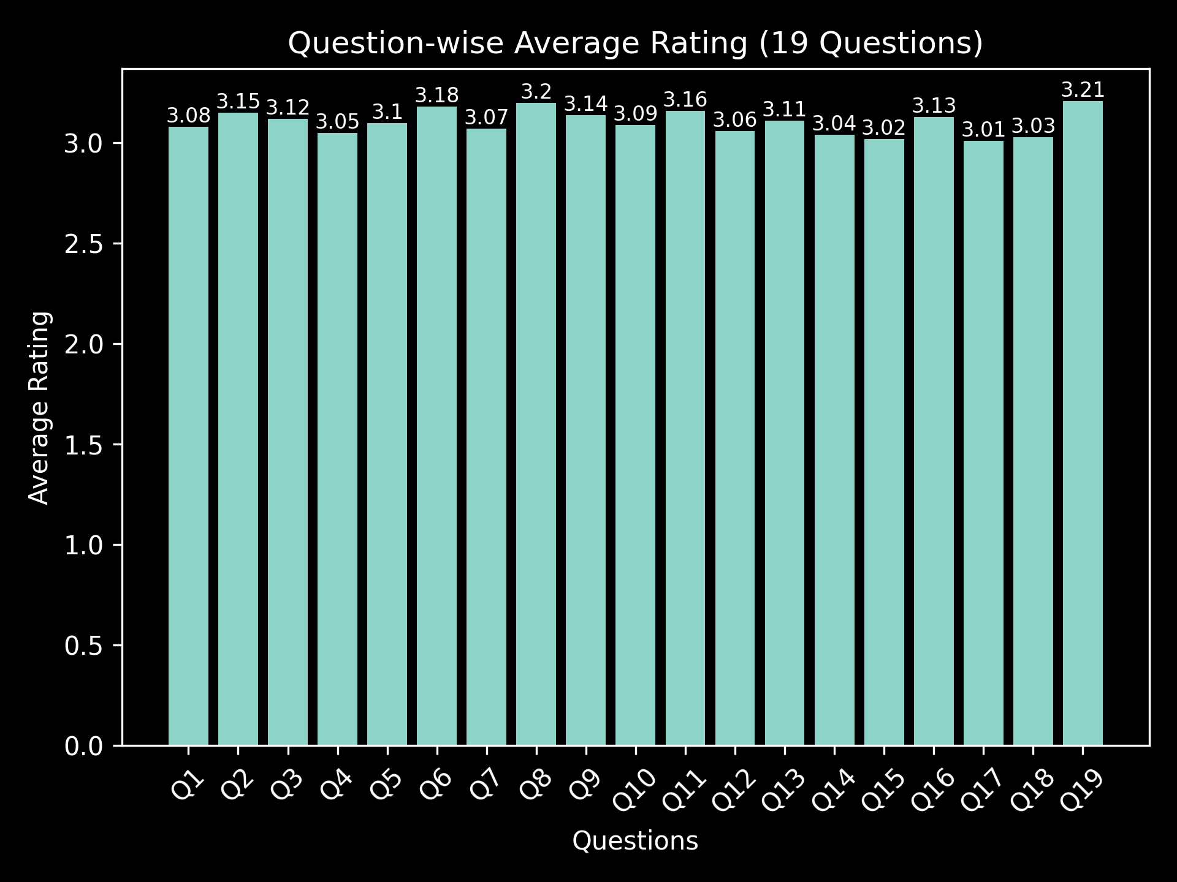

Slide 11
PROBLEM STATEMENT
Educational institutions collect large volumes of student feedback to evaluate teaching effectiveness and course quality.
In this study, 500 responses were collected, covering faculty, courses, departments, and semesters.
However, this data is often underutilized due to lack of structured analysis and proper analytical tools.
While numerical ratings are easy to summarize, textual feedback is difficult and time-consuming to analyze manually.
There is also a lack of integration with AI techniques, making it hard to identify patterns and trends.
As a result, important insights related to performance, student satisfaction, and improvement areas are often missed.
Therefore, there is a need for a data-driven and AI-enabled system to analyze feedback effectively and support better decision-making.

Slide 12
EXPECTED OUTCOMES
The analysis of 500 student feedback responses will produce a clean and structured dataset for academic evaluation.
Development of interactive Pivot Tables and dashboards to visualize:
Faculty-wise performance
Course-wise analysis
Department-wise comparison
Semester-wise trends
Identification of top-performing faculty and courses along with low-performing areas requiring improvement.
Generation of data-driven insights to support academic planning and decision-making.
Implementation of basic sentiment analysis to interpret student comments effectively.
Use of AI-based summarization to extract key themes and recurring issues from feedback.
Improved teaching quality, student satisfaction, and institutional performance through actionable insights.

Slide 13
Creation of a reusable analytical framework that can be applied across different courses, departments, and semesters.
Improved data-driven decision-making for academic planning and performance enhancement.
Ability to track trends and patterns using the 500-response dataset for continuous improvement.
A complete project deliverable including:
Structured dataset (500 responses)
Interactive dashboards (Pivot Tables / Power BI)
AI-generated insights & sentiment analysis
Documentation and project repository
Overall enhancement in teaching effectiveness, student satisfaction, and institutional performance.

Slide 14
THANK YOU

